Slide 1
Lesson 19 – Homework review

Slide 2
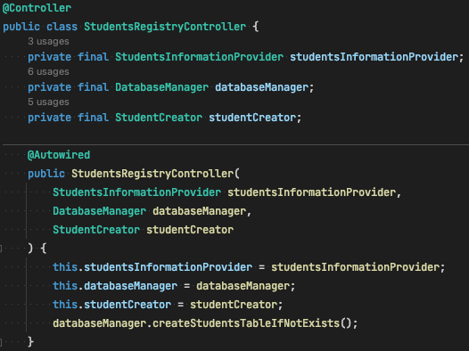
Controller responsibility

Slide 3
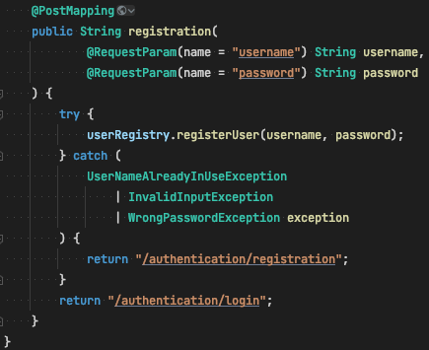
Controller responsibility

Slide 4
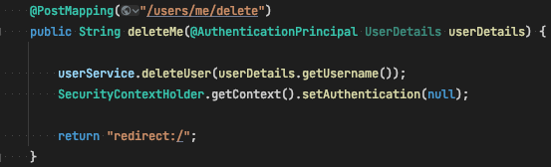
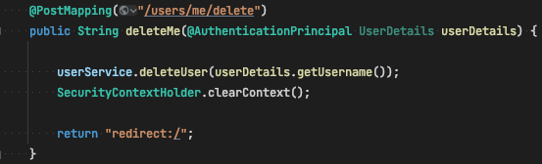
SecurityContext clear

Slide 5
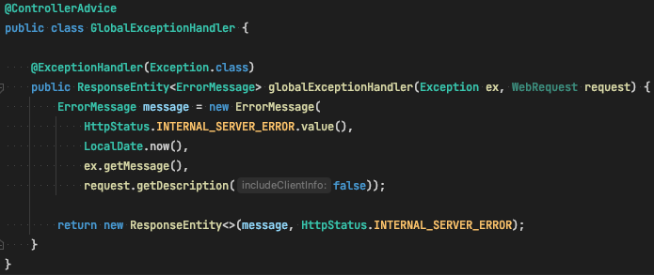
Exception handling and Security

Slide 6
Thanks!
Any Questions?
Or find us in Slack:
@Yaroslav Brahinets
@Vasya Rudas

